Slide 1



PROBLEM
Multiple disconnected systems cause delays, redundant work, and poor user experience for students and staff at University.

Slide 2
SOLUTION
An integrated University Management System that centralizes all modules, simplifies operations, and improves access for students and staff.

Slide 3
MODULE OVERVIEW
The Cashier Module is the heart of the university’s financial system. It makes collecting student payments, issuing receipts, and managing refunds fast, accurate, and hassle-free. With real-time reporting, it ensures smooth financial operations for both students and staff.

Slide 4
KEY FEATURES
ADMIN
The Admin panel manages student forms, orders, payments, receipts, refunds, and user profiles for efficient cashier operations.
STAFF
Staff can access student forms, manage orders, process payments, issue receipts, and handle refunds for smooth transaction flow.
CASHIER
The Cashier handles student forms, manages orders, processes payments, issues receipts, and manages refunds efficiently.
The difference between each User is that the ADMIN user can create, update or delete a user account.

Slide 5
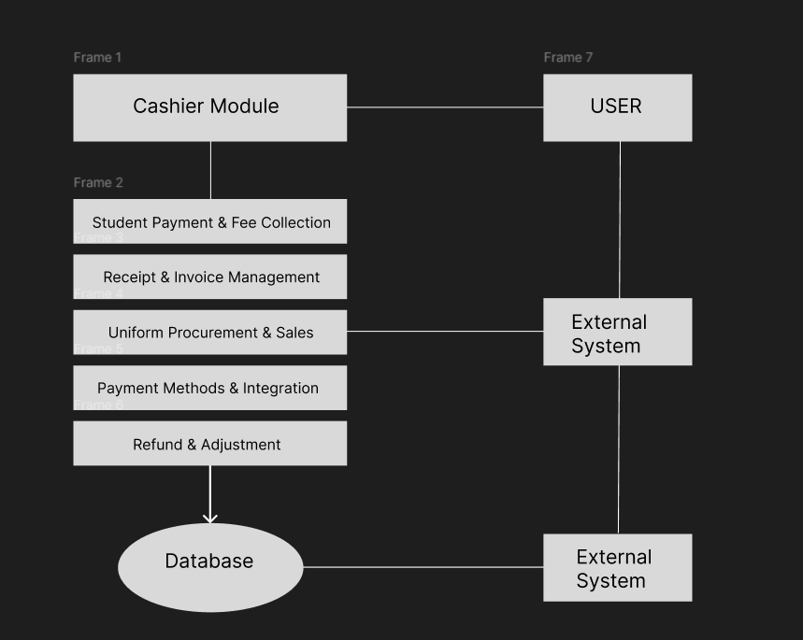
SYSTEM ARCHITECTURE OVERVIEW

Slide 6



TEAM
Jovie A. Arado
Den Clear J. Sombrio
Philip Roger O. Salvador

Slide 7


TAGLINE
"Accurate, secure transactions that build trust through transparent and reliable processes."

